Slide 1

A Little Study on recognizing words
Akansha Chowdhry
Supervisor: Dr. Sara Sereno

Slide 2
Background to word recognition
debate over what, when, where, and how visual word recognition occurs, focusing on the nature of printed word representations and the mechanisms by which they are processed (Carreiras et al., 2014).
Visual word recognition has been investigated using numerous methods such as neuroimaging (Hauk et al., 2006), behavioural studies (Schröter & Schroeder, 2017), and computational studies (Shillcock & Monaghan, 2001).
Variety of models related to word recognition which have been developed to incorporate various tasks like masked priming, lexical decision, eye-movement control and reading aloud.
In recent research, tasks involving masked priming, lexical decision or word naming have been employed more.

Slide 3
Factors influencing word recognition
The usage of tasks such as lexical decision and masked priming, has shown promising results when it comes to what factors influence visual word recognition.
Factors like word length, word frequency, age of acquisition, imageability, gender, concreteness, can have a varying degree of contribution to visual word recognition.
Effects of imageability and age of acquisition have been studied in disyllabic word recognition to show that age of acquisition and imageability effects were larger for words that have a low frequency than high frequency (Cortese & Schock, 2013).
With factors such as frequency, familiarity, phonological similarity controlled, in serial recall of disyllabic word tasks, long words were recalled better than short words (Lovatt et al., 2010).
Concrete words have a processing advantage over abstract words (Fliessbach et al., 2006; Sandberg & Kiran, 2014) using fMRI and training tasks that promote generalisation from trained to untrained items in language therapy.
Through a lexical decision study, it was found that some variables, such as age of acquisition, show significant effects on the reaction time of participants regardless of the type of words used (González-Nosti et al., 2013).

Slide 4
What is this study about?
Age of acquisition? Concreteness?
The aim is to investigate if there are effects of the factors of age of acquisition and concreteness on visual word recognition in native English speakers when other factors of word length, frequency and the proportion they are known by are controlled.
It is hypothesized that age of acquisition and concreteness will influence conceptual processing as seen through the lexical decision task in line with existing literature.
Understanding if there is an interaction between these variables.

Slide 5
Methodology
Repeated measures design
IVs: Concreteness (concrete & abstract) and Age of acquisition (early & late)
DV: Reaction time of word recognition
45 participants (35 female, 10 male) recruited
Completed a lexical decision task
Stimuli for the task were selected using the LexOPS interface (existing norms used to select concreteness and age of acquisition of words and match them for length, frequency and proportion known)
30 early abstract words, 30 early concrete words, 30 late abstract words and 30 late concrete words along with 120 pseudowords and 10 practice words
For lexical decision task, participants were presented with a string of letters where they were required to answer as quickly as possible if the string is a word (e.g., potpourri) or a non-word (e.g., entrophite).
The participants used the right and left control keys to indicate whether the string of letters was a word or non-word respectively.
If they answered incorrectly, the software would flash “INCORRECT” before moving on to the next string of letters.
Participants completed an initial practice block to familiarise them with the procedure of the study followed by four main experimental blocks.

Slide 6
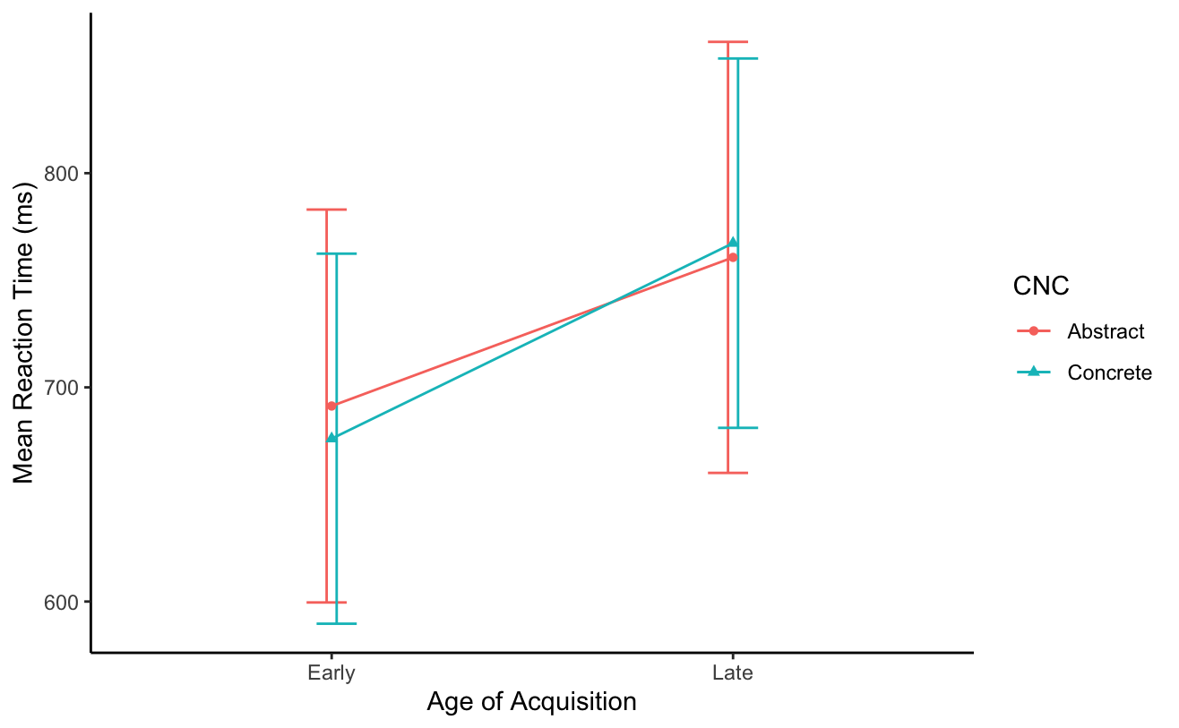
Results
A 2 (AoA: Early, Late) x 2 (Cnc: Concrete, Abstract) analysis of variance (ANOVA) was performed on the data of the participants for their reaction times (RTs).
Crosstabulation of RT means (with SDs in parentheses) across conditions.
Condition | Concrete | Abstract
Early | 676.04 (86.39) | 691.29 (91.72)
Late | 767.32 (86.23) | 760.68 (100.62)
Visualisation of the RT condition means (with standard error bars).

Slide 7
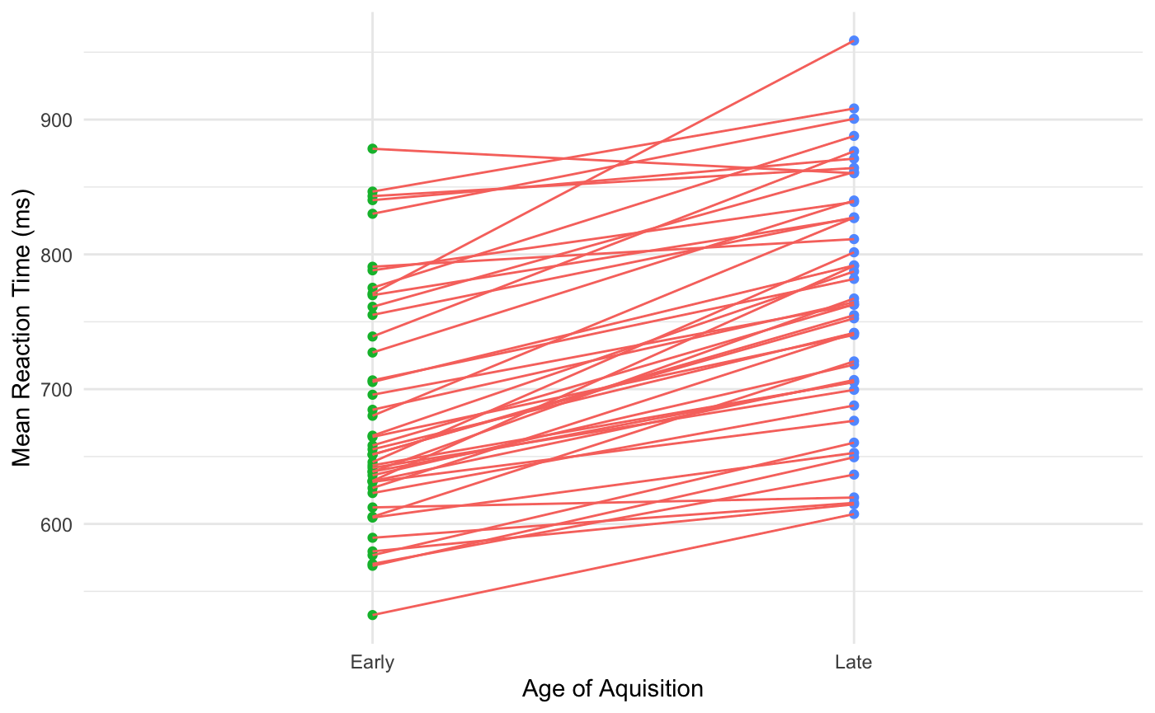
Results
Visualisation of mean reaction time for each subject across early and late acquired words to show robust effect of AoA.

Slide 8
Where do we go from here?
Age of acquisition has a significant influence on word recognition suggesting that words that are acquired early are recognized faster than words that are acquired late.
Concreteness did not have a significant effect on word recognition.
Marginal effect of the interaction.
May be possible to observe a significant effect for this interaction in a larger sample which can be explored in future research.
Controlling for the variables of word length, frequency and proportion known has had an effect on the results not showing a concreteness advantage.
A future area of research: Conducting study in second language English speakers and other languages. Studies show that bilinguals have also shown stronger effects of word frequency in their second language as compared to their first language (Cop et al., 2015).
Methodology can be paired with other non-behavioural investigations which can provide a deeper insight into how the different underlying representations are activated at the time of lexical processing.

Slide 9
Thank you for listening!

